Slide 1



Slide 2


Slide 3
Category Breakdown
There are 5 categories in which your entry can be submitted into. The 5 categories are: Art, Design Technology (D.T.), Writing, Recital, and Information Communication Technology (ICT).
It is important that you choose the category that ‘best fits’ your style of entry. We appreciate that some entries could easily fit into more than one category. It is up to you to decide which features are more dominant. This breakdown, will hopefully support you. We are really hoping we get a wide variety of entries – please be ambitious ☺
Diolch yn fawr!

Slide 4
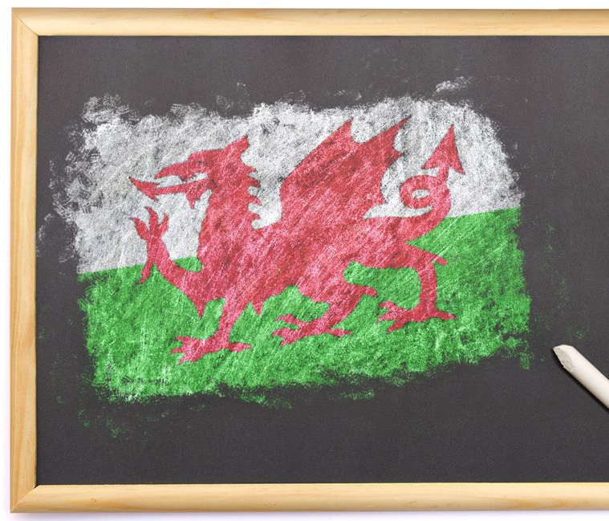
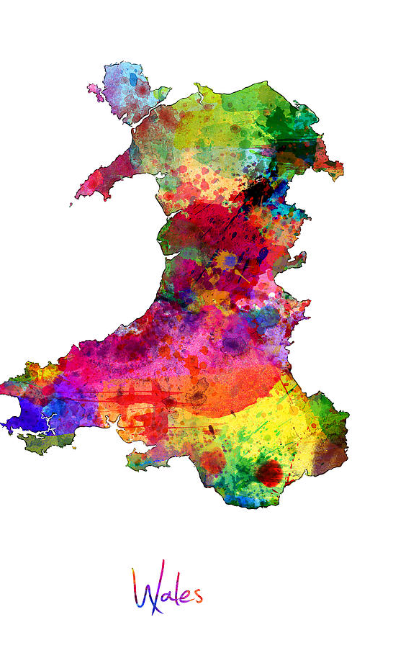
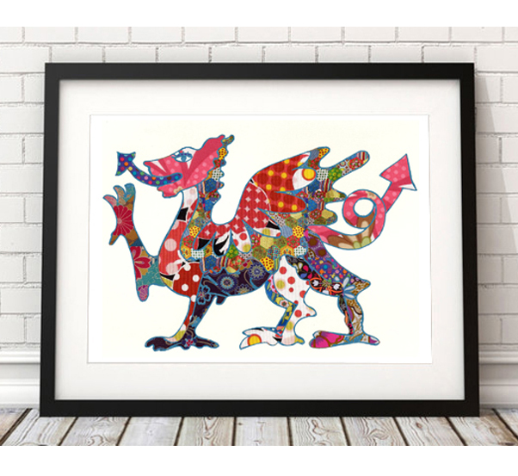
Art
The art category includes creative tasks such as:
Paintings
Drawings
Sketches
Chalk drawings
Entries that are dominant by 2D-shapes, patterns or colour.

Slide 5
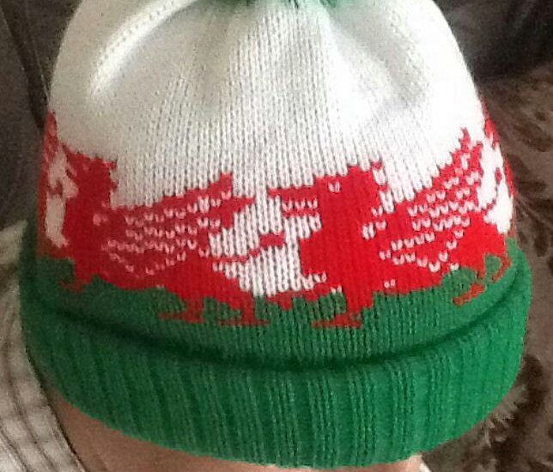
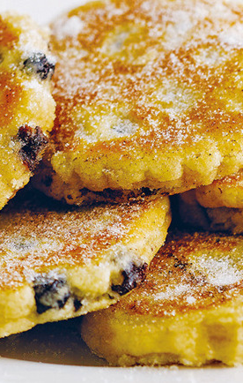
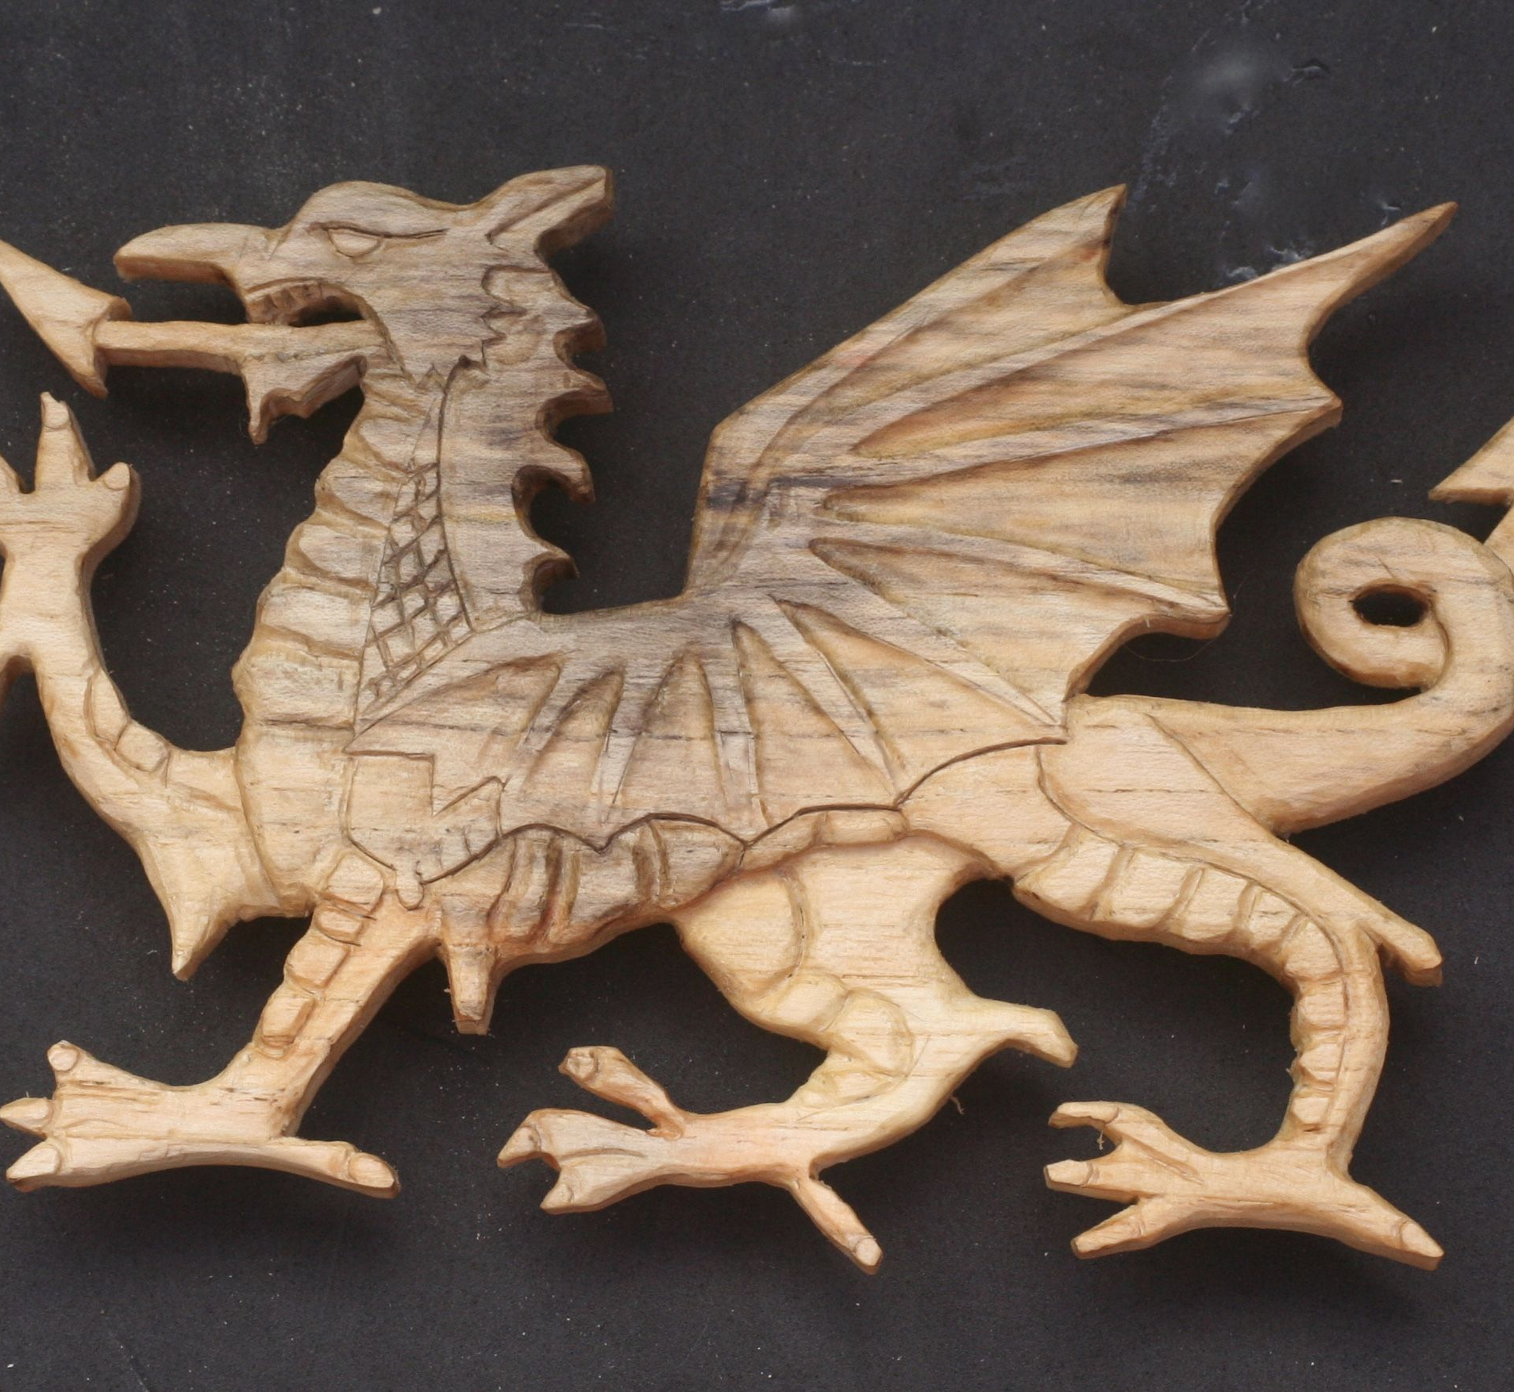
Design Technology
Safety warning first – if you are cooking, using sharp objectives, house-hold materials or heavy materials, please have the help of an adult.
DT involves designing and then building/making something. This could include things like:
Woodwork
Metal work
Using recycled materials
Baking / cooking
Knitting/crochet (fabric work)
Entries that are dominant by using 3-D shapes.

Slide 6

Writing
Writing could be completed through handwriting or through typing. It involves putting your creativity into text and words. Things like:
Poetry
Song writing
A dialogue between two people
Writing a short story
Writing a recount
Letter writing
Describing thoughts, feelings or an image of something
Entries can be written in English or in the Welsh language.
If you would like to re-write something that already exists, that is welcome too, but your teacher must know that it is not original.

Slide 7
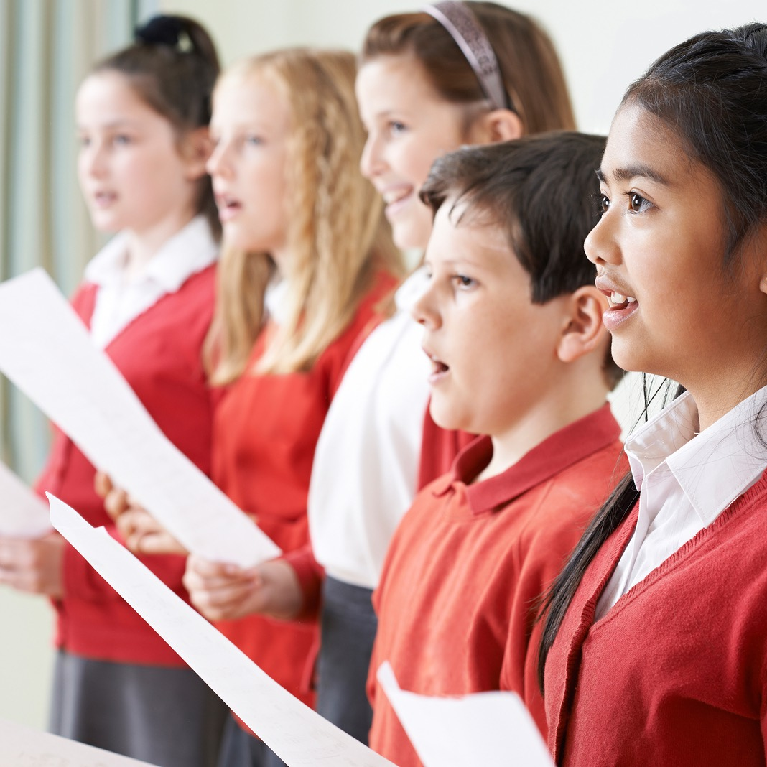
Recital
When we recite, we express through our voice or music. This could include any entry where you:
Sing an existing Welsh song / nursery rhyme
Read an existing poem
Read an existing short story
Perform with a musical instrument
Act / Dramatize a short scene
Read a creative memo / thoughts about Wales
Present an interview with a family member about life in Wales
Read aloud a newspaper article or fictional radio broadcast
Present all the things that make you proud to be Welsh.

Slide 8



Information Communication Technology (ICT)
Any entry where the use of a computer or digital device has been at the core of your creativity should be placed in this category. This may include things like:
PowerPoint / Google Slide Presentations
Photography / Digital collages
The use of any Hwb platform software or Apps
Film making / editing software
Coding
(please consider the location, source and size of your files before submitting them to your teacher)

Slide 9


