Slide 1
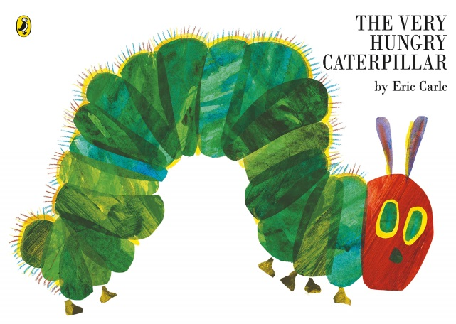
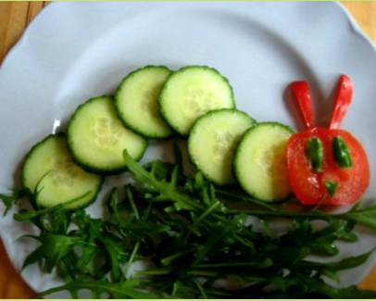
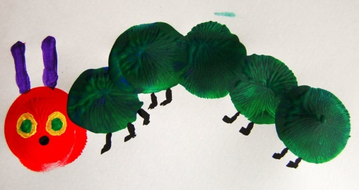
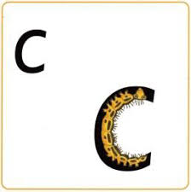
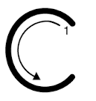
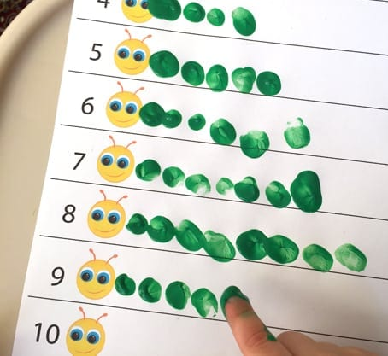
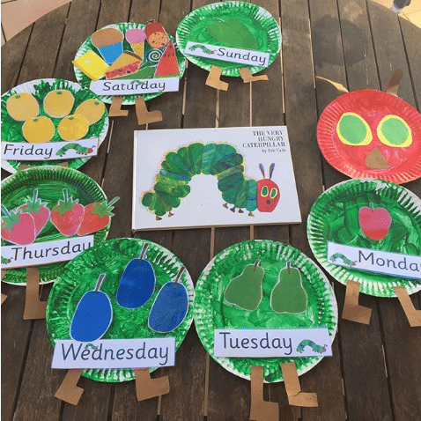
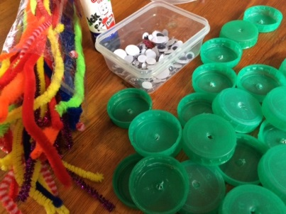
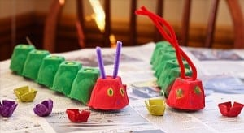
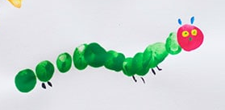
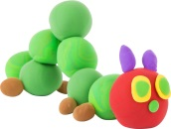
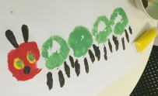
Ideas for home-learning
The Very Hungry Caterpillar 1
First of all, listen to the story. You can listen to Miss Harte read it on the school website and, if you have a copy of the book at home, a grown-up can read it to you, and you can then talk about it together. The author, Eric Carle, reads the book on YouTube but I would always ask parents to watch YouTube videos all the way through before playing them to your child, to check for content and suitability. (Always supervise your child when on the internet.) When you have listened to the story and talked about it, you could try some of the ideas on this page. You might have ideas of your own too.
What foods do you like eating? Can you draw a picture of the foods you like?
Have you tried eating all the different foods in the story? Which food is your favourite? Some of the foods are healthy and some are foods that you should only have as a treat. Which are which? Talk about this with a grown-up.
Make an edible caterpillar out of food. You can eat it afterwards.
Practise writing the letter 'c'. Start at the top and say 'Curl around the caterpillar' as you write.
Make caterpillars with bodies of different lengths. You could use milk bottle tops, buttons, or you could paint your caterpillars. Count the number of body parts.
c
Paint or draw the very hungry caterpillar. If painting, you could use a paintbrush or your fingers, or you could print the caterpillar using something round, dipped in paint. Or how about turning your handprints into the caterpillar?
Make a 3-D caterpillar - you could us playdough, modelling clay, milk bottle tops, egg boxes, or any recycled materials you can find.
Ask your grown-up to write down the days of the week. Next to each day, draw what the caterpillar ate. Can you count the food? If you have the book, point and count the food on each page.

Slide 2
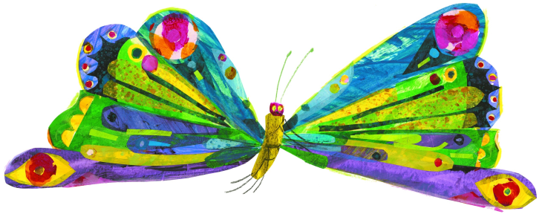
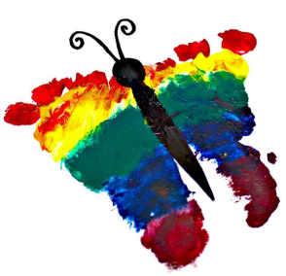
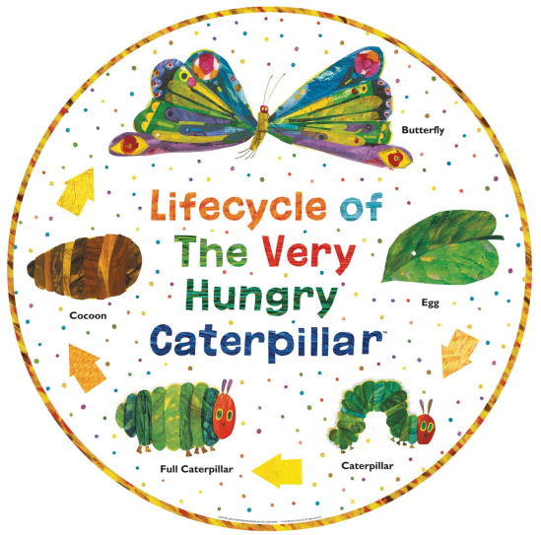
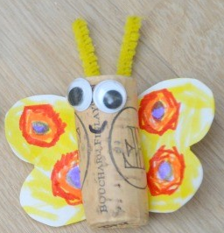
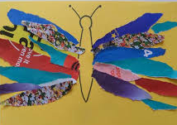
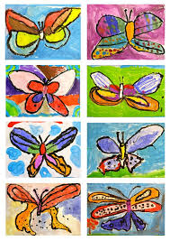
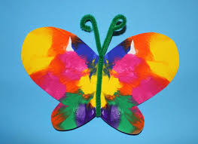
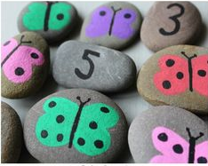
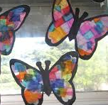
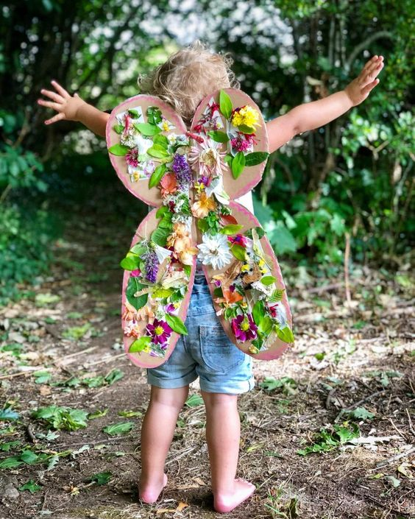
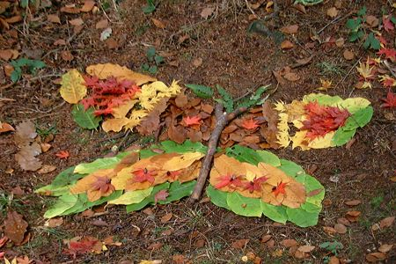
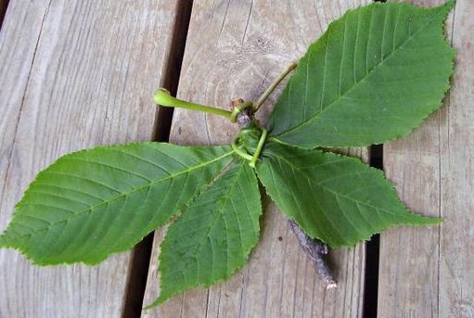
Ideas for home-learning
The Very Hungry Caterpillar 2
At the end of the story, the caterpillar turns into a butterfly. Here are some home-learning ideas related to butterflies.
On your daily walk, see if you can spot any butterflies or caterpillars. Take a photograph or draw what you saw.
How about making a
footprint butterfly?
Paint your feet
and then stand on
your paper!
Can you draw or paint a butterfly? You could make a butterfly by folding a piece of paper in half, painting on one side, pressing the other side onto it and then opening it up to see your symmetrical butterfly.
Learn about the life-cycle of a butterfly.
How about making a butterfly collage? You can use any scraps of paper or material. Or you could make a 3-D butterfly, using recycled materials. You could make a butterfly from things you find in your garden.
Make some butterfly counting and number stones.
Make a butterfly suncatcher/ stained-glass window.
Make some butterfly wings to wear.

